Slide 1

Nalaiyathiran
Team Id:PNT2022TMID13271
College Name : P.S.R. Engineering College, Sivakasi

Slide 2
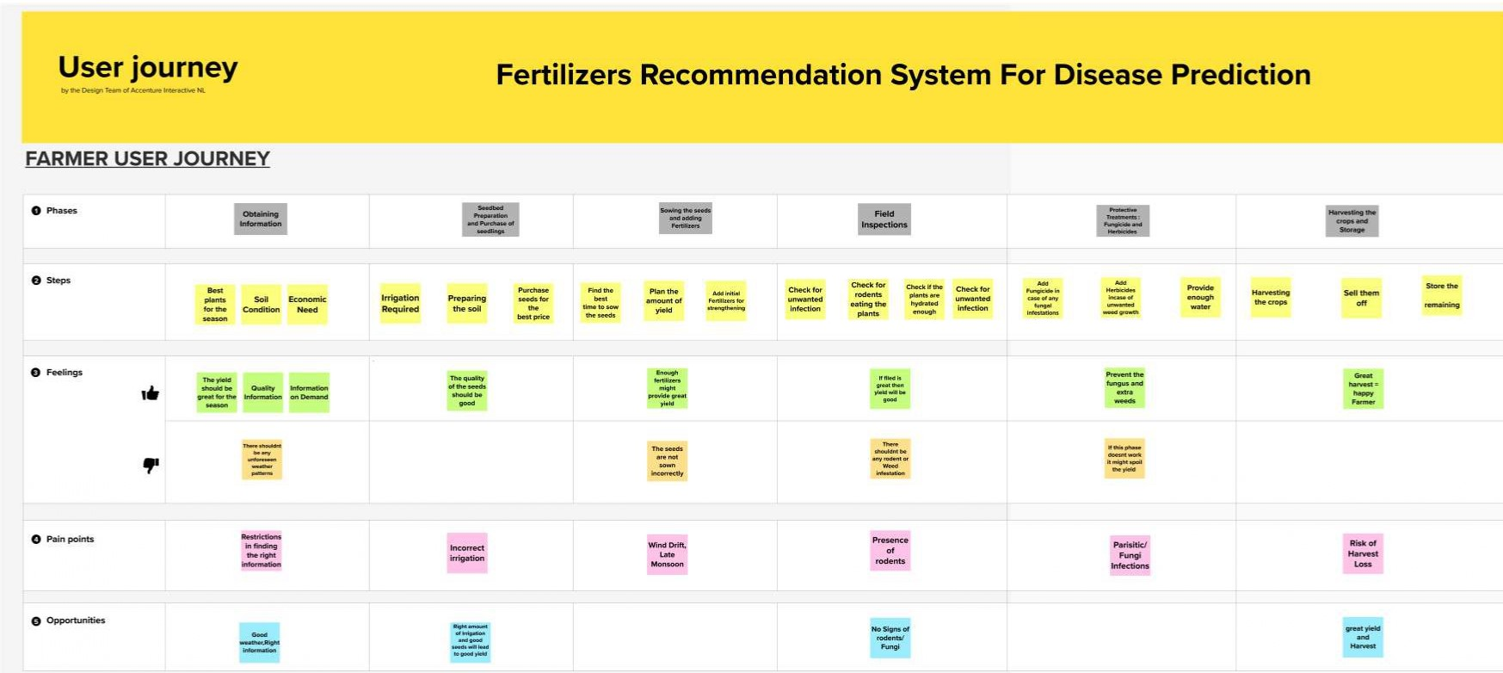
CUSTOMER JOURNEY MAP

Slide 3
FUNCTIONAL REQUIREMENTS
FR No. | Functional Requirement (Epic) | Sub Requirement (Story / Sub-Task)
FR-1 | User Registration | Registration through Form
FR-2 | User Confirmation | Confirmation via Email
FR-3 | User Profile | Filling the profile page after logging in
FR-4 | Uploading Dataset (Leaf) | Images of the leaves are to be uploaded
FR-5 | Requesting solution | Uploaded images is compared with the pre-defined Model and solution is generated
FR-6 | Downloading Solution | The Solution in pdf format which contains the recommendations of fertilizers & the possible diseases.

Slide 4
NON-FUNCTIONAL REQUIREMENTS
NFR No. | Non-Functional Requirement | Description
NFR-1 | Usability | The system allows the user to perform the tasks easily and efficiently and effectively.
NFR-2 | Security | Assuring all data inside the system or its part will be protected against malware attacks or unauthorized access.
NFR-3 | Reliability | The website does not recover from failure quickly, it takes time as the application is running in single server
NFR-4 | Performance | Response Time and Net Processing Time is Fast
NFR-5 | Availability | The system will be available up to 95% of the time
NFR-6 | Scalability | The website is scalable

Slide 5
TEAM LEAD M.JEEVAMUKESH (951919CS032)
TEAM MEMBERS
A.ARAVINTH (951919CS011)
M.KALIMUTHU MADASAMY (951919CS035)
V.MUTHUKUMAR (951919CS059)
M.MUTHURAJ (951919CS060)

Slide 6
THANK YOU

